Slide 1
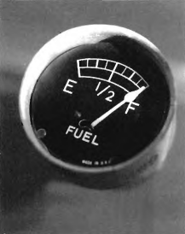

Slide 2
(A) The gauge shows that the tank is empty.
(B) The gauge shows that the tank is half-empty.
(C) The gauge shows that the tank is full.
(D) The gauge is square-shaped.

Slide 3
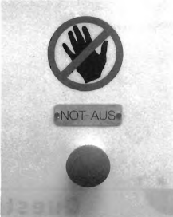

Slide 4
(A) The sign means go straight.
(B) The sign means do not speed.
(C) The sign means do not touch.
(D) The sign means touch.

Slide 5
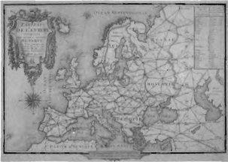

Slide 6
(A) This is a map.
(B) This is a television.
(C) This is a book.
(D) This is a blanket.

Slide 7
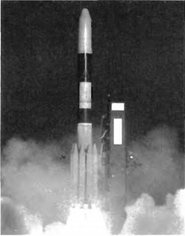

Slide 8
(A) The astronauts are in the rocket.
(B) The rocket is taking off.
(C) The people are taking pictures of the rocket.
(D) The rocket is landing.

Slide 9
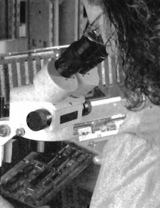

Slide 10
(A) The woman is looking around the microscope.
(B) She is looking for the microscope.
(C) She is looking through the microscope.
(D) The woman is looking at the microscope.

